Slide 1
CGB1201 – JAVA PROGRAMMING
Department of Artificial Intelligence and Data Science
Academic Year: 2024 – 2025 (Odd Semester)
Register Number : 2303811724321067
Name : MOHAMED FIRDOUS S
Year : II
Semester :III
Section : B
Date :03-12-2024

Slide 2
Title of the Project
STOCK MANAGEMENT SYSTEM

Slide 3
Problem Identification
Stock Management Complexity: Managing inventory levels and orders is often inefficient and error-prone in manual systems.
Real-Time Updates: Lack of real-time updates on stock availability leads to stockouts or overstocking.
Customer Satisfaction Issues: Inefficient management affects order fulfillment and customer satisfaction.

Slide 4
Objective
Streamline Inventory Management: Automate stock tracking and replenishment.
Ensure Real-Time Updates: Provide real-time inventory status to minimize stockouts or overstock situations.
Improve Decision-Making: Facilitate better planning with accurate reporting of inventory data.

Slide 5
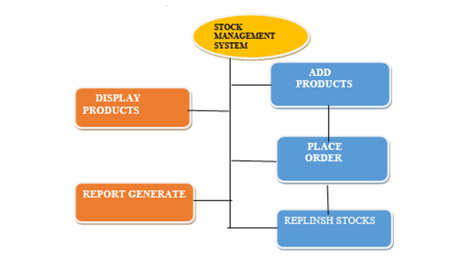
Proposed Architecture

Slide 6
Java Programming - Concepts Used
Object-Oriented Programming: Encapsulation and modular design with Product class and methods.
AWT Event Handling: Implementing ActionListener for interactive user inputs.
Collections Framework: Using HashMap for efficient product catalog management.

Slide 7
List of Modules
Product Management
Order Placement
Stock Replenishment
Report Generation

Slide 8
Module Description
Product Management
Handles adding new products, updating existing product details, and storing them in a centralized product catalog.
Provides input fields for product name, ID, quantity, and price.
Order Management
Processes customer orders by checking product availability, updating stock levels, and notifying the user about order success or failure.
Prevents over-ordering by validating stock quantities.
Stock Replenishment
Allows users to restock products by adding specific quantities to existing inventory.
Updates the product catalog in real-time to reflect replenished quantities.

Slide 9
Module Description (Cont..)
Report Generation
Generates detailed reports of the current inventory, including product names, IDs, stock levels, and prices.
Aids in decision-making by providing insights into stock performance.

Slide 10
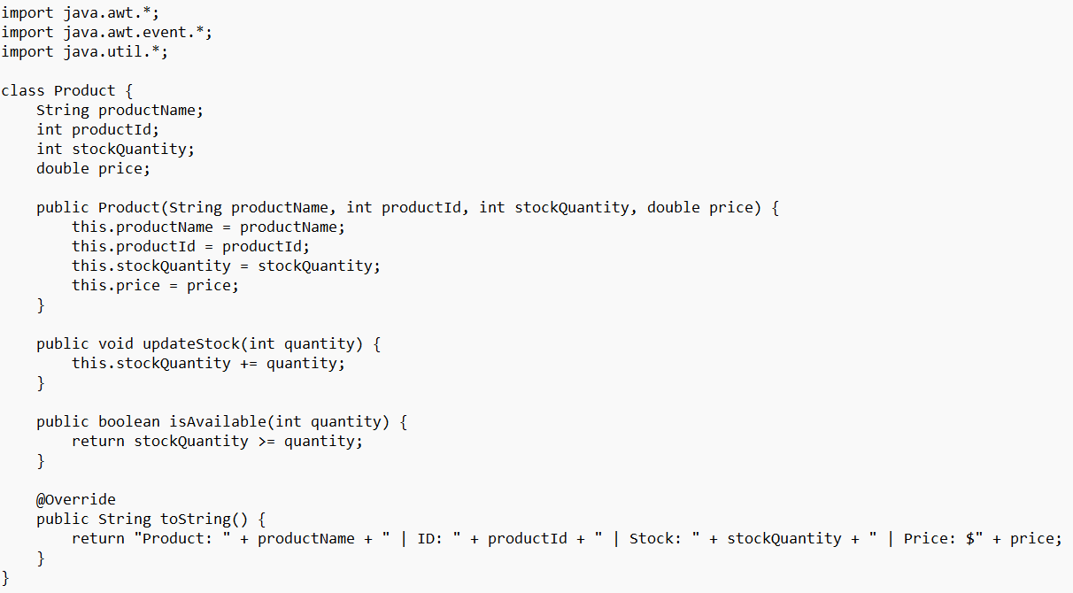
Source Code

Slide 11
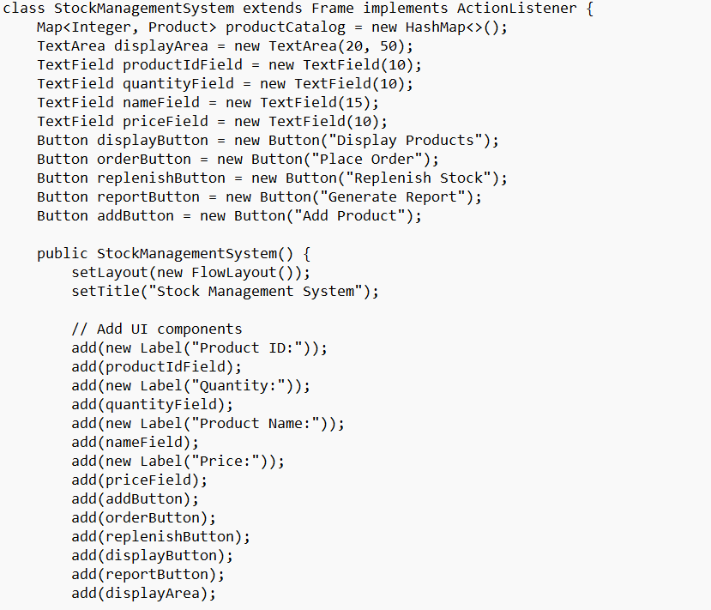
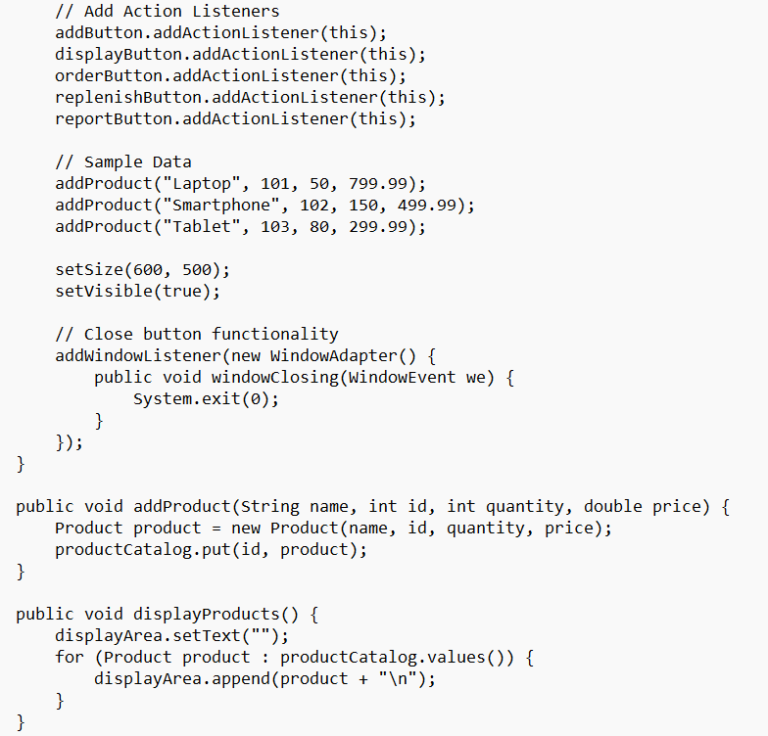
Source Code
CGB1201 – JAVA PROGRAMMING

Slide 12
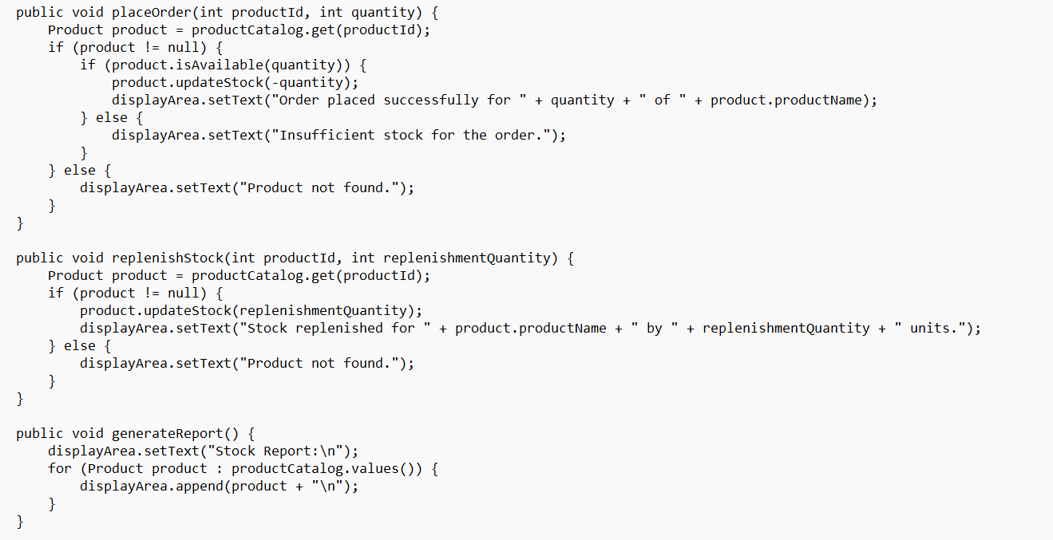
Source Code
CGB1201 – JAVA PROGRAMMING

Slide 13
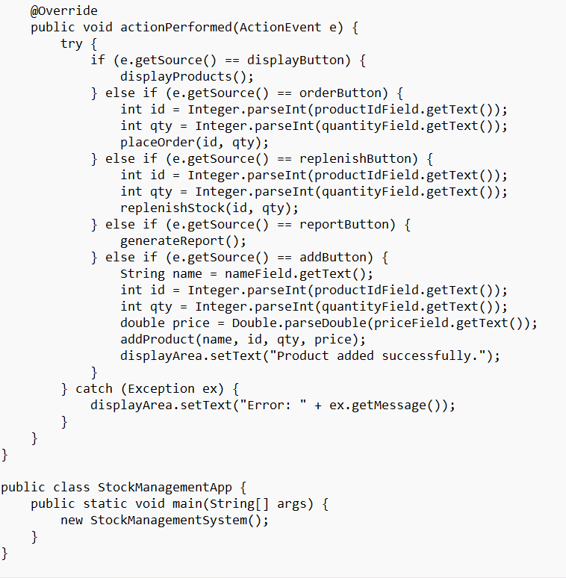
Source Code
CGB1201 – JAVA PROGRAMMING

Slide 14
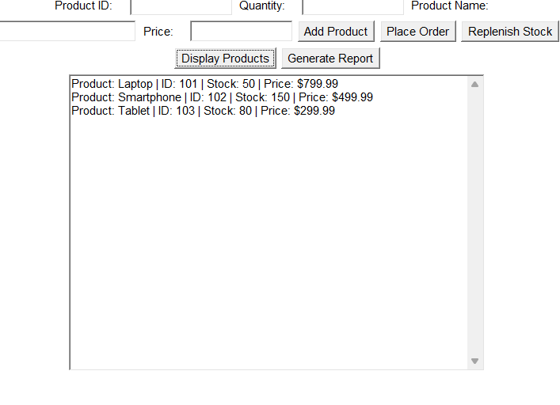
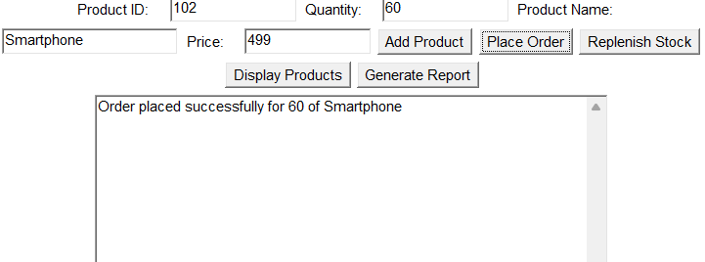
Results
Display Products
Place Orders

Slide 15
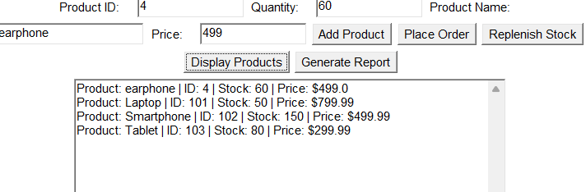
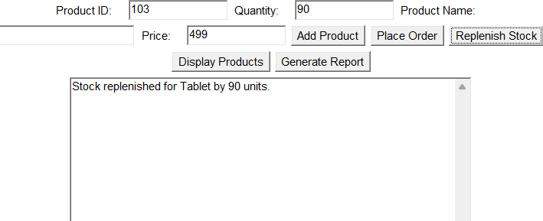
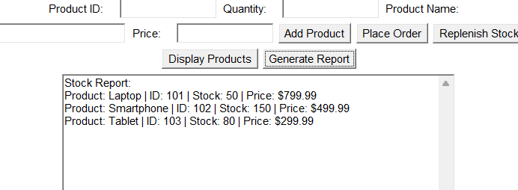
Results
Add Products
Replenish Products
Stock Report

Slide 16
Conclusion
The project provides an efficient, user-friendly solution for managing stock, addressing common challenges in inventory systems. By leveraging Java's robust features and modular design, it ensures streamlined operations, accurate reporting, and better inventory control.

Slide 17
Thank You

